Slide 1
EFFICIENT BRAIN SEGMENTATION FOR 3D PRINTING APPLICATIONS
By: A Vidya Preetha (312313106183)
Guided by : Dr. S. Rajesh Kannan

Slide 2
OBJECTIVE
To obtain the most effective segmentation by using a procedure that combines statistically-based segmentation techniques with partial differential equation-based methods using Adaptive Mean Shift Modified Fuzzy C Means (AMS FCM) algorithm which is best suited for 3D printing applications.

Slide 3
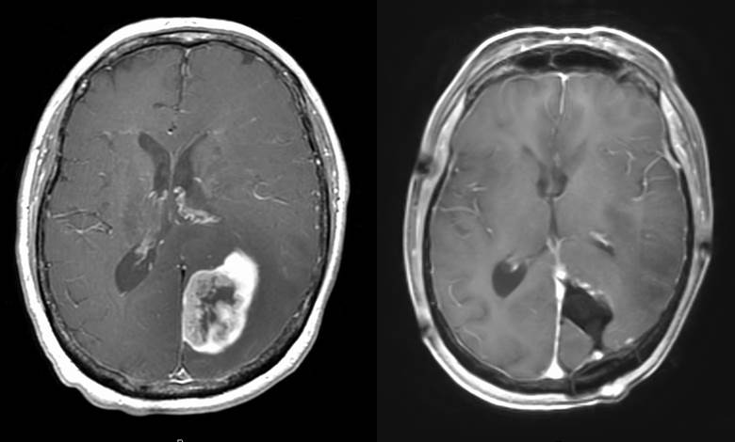
INTRODUCTION
Brain tumour : Cells grow and multiply uncontrollably.
Types : Metastatic Benign
Malignant
Brain matter and its relevance : Cerebellum Mesencephalon Telencephalon
Behavioral Classification : Uncontrolled mitosis Anaplasia

Slide 4
Generalised methods of Diagnosis with imaging :
MRI (Magnetic Resonance Imaging)
CT (Computed tomography)
Algorithms used here :
Fuzzy C Means algorithm - C stands for clustering.
Basic concept : Clustering – process of partitioning or grouping a given sector unlabeled pattern into a number of clusters such that similar patterns are assigned to a group, which is considered as a cluster.

Slide 5
LITERATURE SURVEY
S.No | Title | Year of Publication | Proposed work | Drawback
1 | Image Segmentation using fuzzy C means Clustering -A survey – M.A Balafer | 2010 | Conventional 1 fuzzy c means algorithm for segmentation of MRI brain image. | This paper requires more prepossessing techniques. Clustering is improper.
2 | A modified Fuzzy C Means Clustering with Spatial information for image segmentation- Chan & L.Vese | 2013 | Modified FCM algorithm foe segmentation of MRI brain image. | Use in imaging applications is a major drawback, however, FCM does not incorporate information about spatial context.

Slide 6
S.No | Title | Year of Publication | Proposed Work | Drawback
3 | Improved Fuzzy C Means Algorithm for MRI brain image segmentation – A. Ramli | 2014 | Weighted fuzzy C- means algorithm for segmentation of MRI brain image | Non cancer pixels are segmented as cancer pixels. The region of interest is not correct.
4 | Medical image retrieval using medical moments – Paul .K.Wright | 2015 | Zernike moment classification | The feature extraction is implemented. The feature selection is not implemented and hence low accuracy.

Slide 7
Inferences from literature survey
Intensity based Region-growing segmentation –
□ Limited range of applications and automatic features are not having accurate values and has speckle, salt and pepper and gaussian noise.
□ The region growing algorithm will segment not only the tumour area but also the non tumour area which has high intensity ratio.
□ We have to manually assign the values of the centroid to facilitate clustering.
Proposed System –
□ Adaptive region growing method based on the gradients and variances.
□ Can reduce the number of iterations, which leads to a significant reduction in the computational cost while attaining similar levels of accuracy.

Slide 8
PROPOSED MODEL
METHODOLOGIES
Image Restoration
Image De-noising using Anisotropic Diffusion fusion Filter
2. Image Enhancement
Image Enhancement using Adaptive Mean Adjustment (AMA)
3. Image Segmentation
AMS based Modified Fuzzy C Means Clustering Segmentation (AMS– MFCM)
4. Image Feature Extraction
2D Discrete Wavelet Transform and GLCM (Gray level co- occurrence matrix)
5. Classification
Classification using Neuro-SVM (Support Vector Machine)
6. Proposed Algorithm 6 – 3D modeling
3D modeling of segmented tumor

Slide 9
IMPLEMENTATION ENVIRONMENT
MATLAB 2011 version
Toolbox – Digital Image processing Toolbox

Slide 10
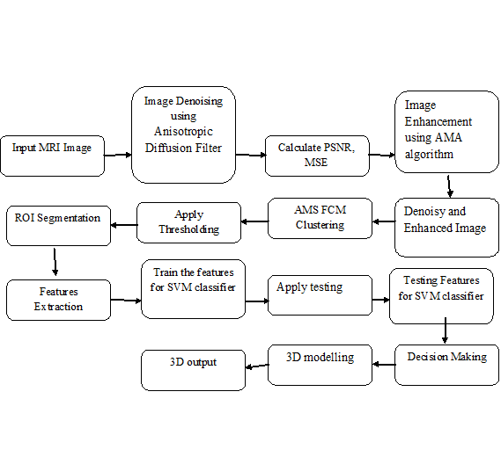
BLOCK DIAGRAM

Slide 11
IMAGE RESTORATION
Image De-noising using Anisotropic Diffusion Filter
Relation between linear diffusion filtering and the convolution with a Gaussian.
Analyze its smoothing properties for the image as well as its derivatives.
Review the fundamental properties of the Gaussian scale-space induced by linear diffusion filtering.

Slide 12
ALGORITHM
Image acquisition
◊Calculate Row Column Dimension (Layers) of the Image
◊If input image is RGB, then convert it into Gray format to calculate the intensity of the input image
De-noising or Restoration
◊Number of Iterations to be de-noised
◊Double Precision - to improve the MATLAB Memory
◊Spacing between X and Y Directional coordinates
◊2D convolution masks

Slide 13
◊Performs multidimensional filtering using convolution
◊2D Convolution Filter ends here
Discrete Partial Differential Function to Reconstruct the Image
◊Fusion=Im(x,y)+sf*(1/yd^2)*Fc(I,j)
Where
Im is the noisy image
Sf – scaling factor
Yd – spacing between pixels
Fc – Filter response coefficients

Slide 14
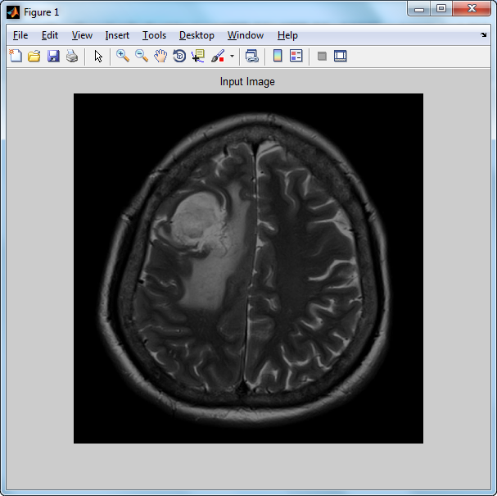
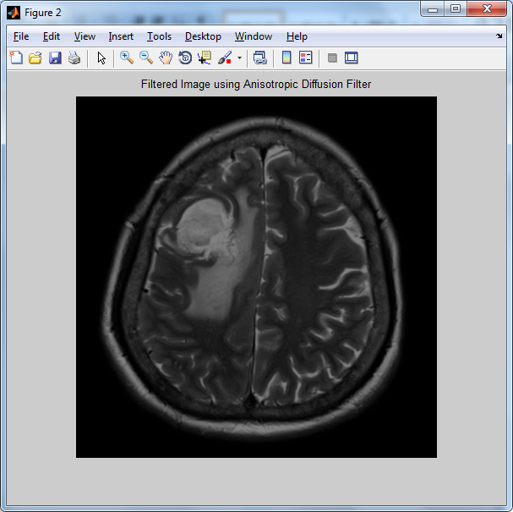
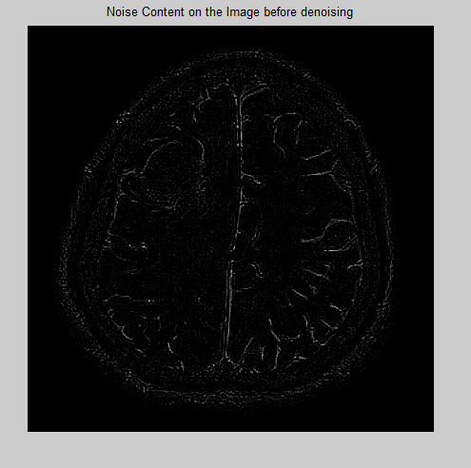

Slide 15
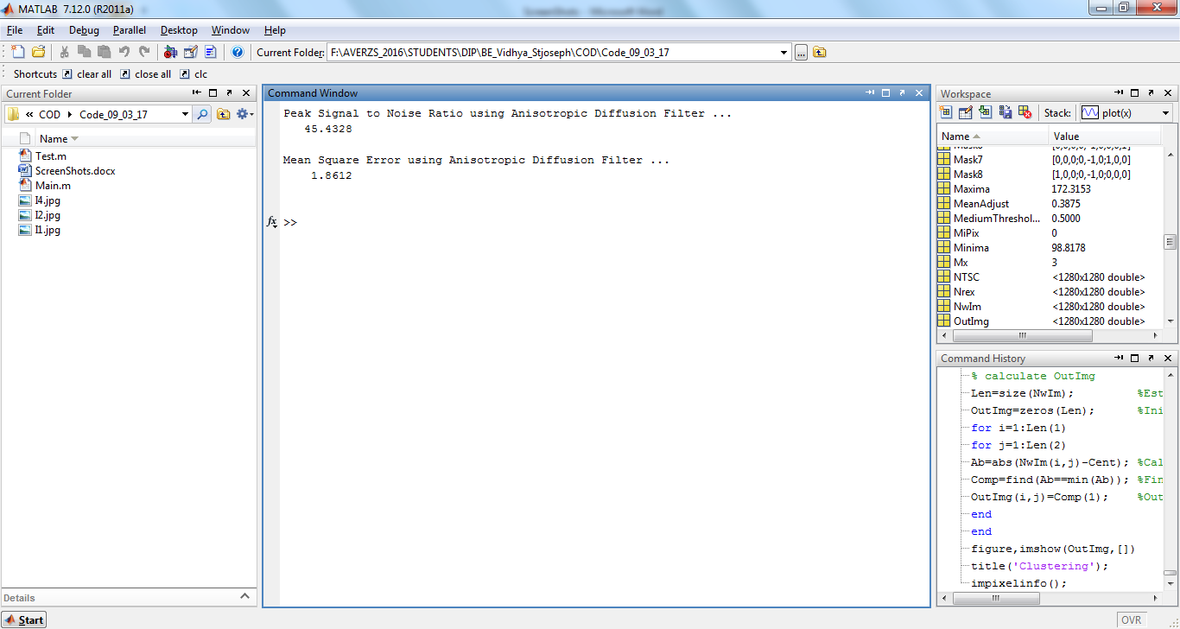

Slide 16
IMAGE ENHANCEMENT
Adaptive Mean Adjustment (AMA)
Computer image processing technique used to improve contrast in images.
Adaptive method computes several histograms, each corresponding to a distinct section of the image.
Suitable for improving the local contrast of an image and bringing out more detail.

Slide 17
ALGORITHM
Input the Filtered Image
Case 1: Gray Scale Image
◊Set the thresholding values (Median)
◊Set Lower and Upper thresholding values to calculate the Minima and Maxima
◊Apply the double Precision to the Image
◊Apply Normalization
◊Calculate the Mean of the Gray Scale Value
◊Adjust the Mean Value

Slide 18
Case 2 – RGB Image
◊Set Lower and Upper thresholding values to calculate the Minima and Maxima
◊Color Image Thresholding (Image Bandwidth)
◊Convert from RGB to NTSC Color format (to Improve Luminance, the intensity of light emitted from a surface per unit area in a given direction)
◊Calculate the Mean adjust value for Green layer using Color Image Upper Thresholding

Slide 19
Calculate the Mean adjust value for Blue layer using Color Image Lower Thresholding
For Case 1 and Case 2:
◊Mean Adjustment for First Layer
◊Calculate Minima and Maxima
◊Apply formula (Image-Minima/Maxima-Minima)
◊Enhanced Image Output
Enhanced Image={Im(x,y)/Imin(x,y)}/Imax(x,y)/Imin(x,y)

Slide 20
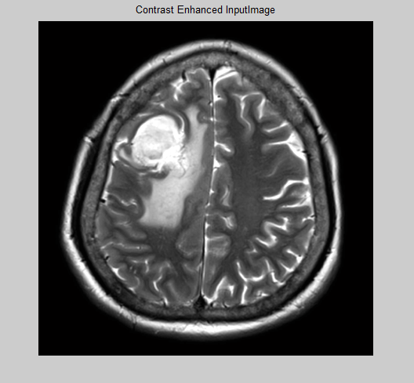

Slide 21
IMAGE SEGMENTATION
AMS based Modified Fuzzy C Means Clustering Segmentation (AMS– MFCM)
Overcome the problem of existing system tumor segmentation mishandling by initializing standard membership values.
After the completion of initial clustering process, the clusters were updated in turn updates the cluster weights and membership degree.

Slide 22
ALGORITHM
Initialize the Class. K indicates the Weight Index for clustering
Double Precision of the image
Convert M x N Matrix into M x 1 Matrix in order to simplify the mathematical process
Calculate the Minima of the pixel
Calculate the posteriori probability using Baye's Rule
Calculate the length of the matrix
Estimate the Maxima of the image pixel & Calculate the Histogram of the maxima pixel by adding 1
Initiate Empty (Zero) Buffer 1

Slide 23
Estimate intensity pixels by comparing the Histogram of each pixels
Find the Location of the intensity pixels
Length of the Intensity Pixels
Calculate the centre point using Histogram
Calculate the absolute centroid position between central point and the Location of the intensity pixels
Find the Minima of the above difference
Restore the clustered pixels in the buffer
Apply the Otsu thresholding on the clustering image
Apply the Morphological operation to do the post processing process

Slide 24
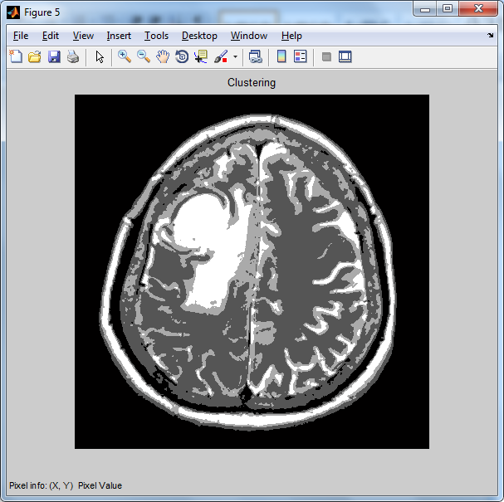
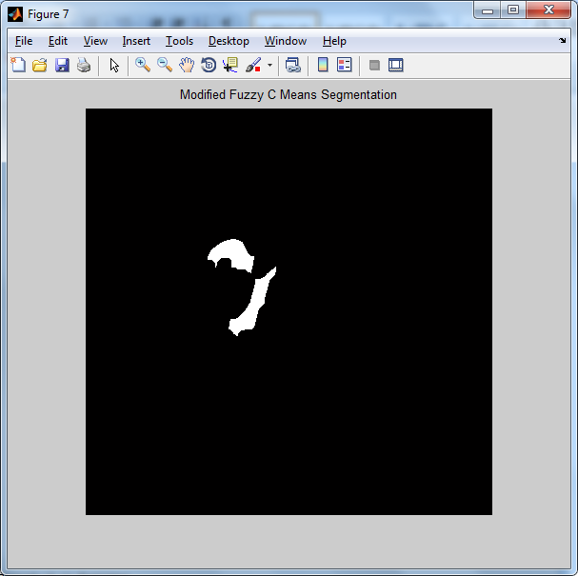

Slide 25
FEATURE EXTRACTION
2D Discrete Wavelet Transform and GLCM
Autocorrelation
Amplitude
Contrast
Correlation
Cluster Prominence
Cluster Shade
Dissimilarity
Energy
Entropy
Homogeneity
Maximum probability
Sum of squares
Sum average
Sum variance
Sum entropy
Difference variance
Difference entropy
Information measure of correlation 1 & 2
Inverse difference normalized.
Maximal correlation coefficient
Inverese difference moment

Slide 26
Requirements of feature extractions
Represent the image in its compact and unique form of single values or matrix vector.
Low level feature extraction involves automatic extraction of features from an image without doing any processing method.
High level feature extraction technique to investigate the narrow and broad weed by implementing the 2 dimensional discrete wavelet transform (2D-DWT) as the processing method.

Slide 27
GLCM FEATURES
Autocorrelation
Maximum Probability

Slide 28
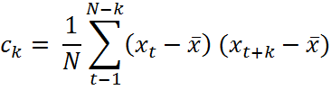
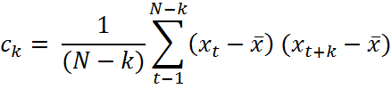


Inverse differential normalization
Inverse differential moment normalization
Minimal correlation coefficient
Sum of Average

Slide 29
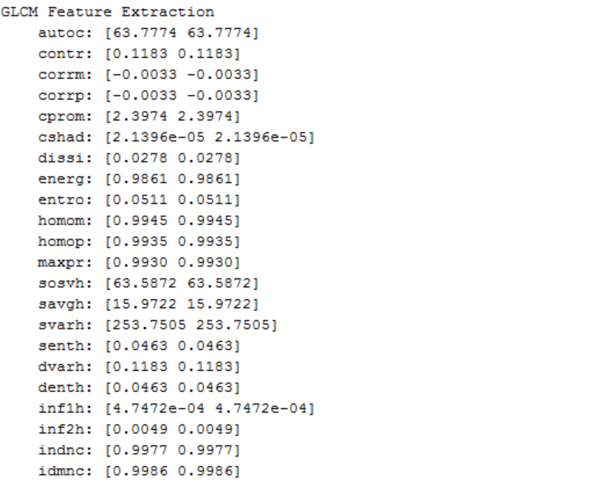

Slide 30
classification
Support Vector Machine
Classification techniques based on Support Vector Machines (SVM) are proposed and applied to brain image classification.
In this project feature extraction from MRI Images will be carried out by gray scale, symmetrical and texture features.
Higher accuracy rate and lower error rate of MRI brain cancer classification using SVM.
Neural network is used for the training purpose.

Slide 31
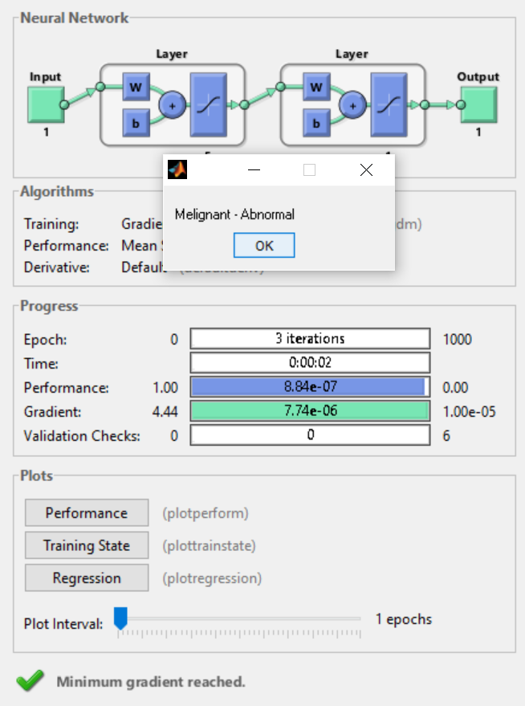

Slide 32
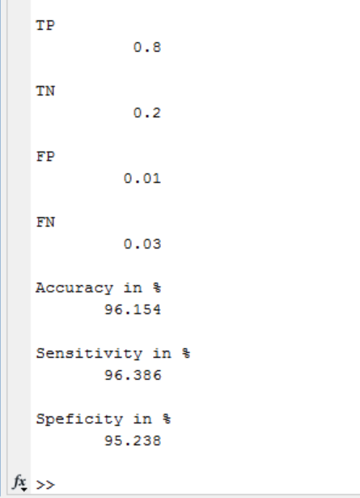
ACCURACY TESTING
Accuracy = (TP + TN)/(TP + FP + FN + TN)
Sensitivity = TP / (TP + FN)
Specificity = TN / (FP + TN)
where, TP- True Positive
TN- True Negative
FP- False Positive
FN- False Negative

Slide 33
3d modelling
3D modeling of segmented tumor
Embossify software
Stl file is created
Convert it to a viewable format
Provide the necessary properties
Analyze the 3D image

Slide 34
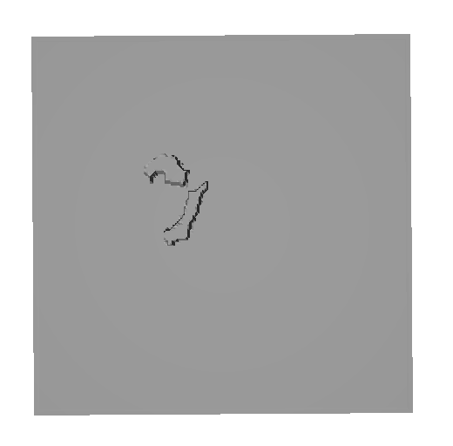
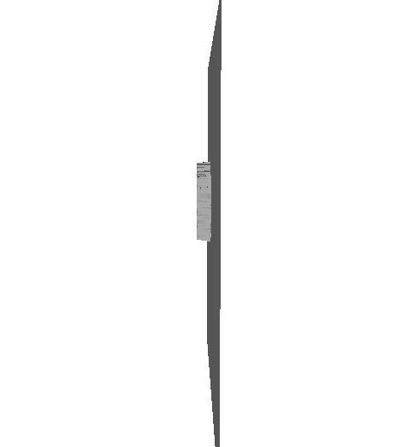
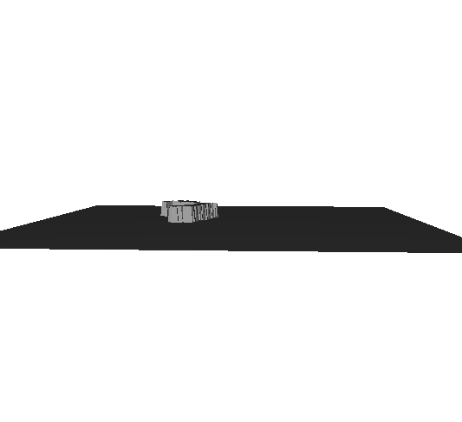
3D OUTPUT
Top view
Front view
Side view

Slide 35
CONCLUSION
Hence, an MRI has been examined and can be segmented successfully with advanced techniques with improvement in the parameters over the currently available methodologies.
An efficient 3D printing of the particular MRI can take place successfully.

Slide 36
REFERENCES
[1] M. A. Balafar, A. R. Ramli, M. I. Saripan, and S. Mashohor, “Review of brain MRI image segmentation methods,” Artificial Intelligence Review, vol. 33, no. 3, pp. 261–274, January 2010.
[2] M. B. Panzer, B. S. Myers, B. P. Capehart, and C. R. Bass, “Development of a finite element model for blast brain injury and the effects of CSF cavitation,” Annals of Biomedical Engineering, vol. 40, no. 7, pp. 1530–1544, February 2012.
[3] S. Budday, P. Steinmann, and E. Kuhl, “The role of mechanics during brain development,” Journal of the Mechanics and Physics of Solids, vol. 72, pp. 75–92, December 2014.
[4] T. Chan and L. Vese, “Active contours without edges,” IEEE Transactions on Image Processing, vol. 10, no. 2, pp. 266–277, 2001.
[5] M. Balafar, A. Ramli, M. Saripan, R. Mahmud, and S. Mashohor, “Medical image segmentation using fuzzy c-mean (fcm) and dominant grey levels of image,” in Visual Information Engineering, 2008. VIE 2008. 5th International Conference on, July 2008, pp. 314–317.
[6] Material Characterization of Fused Deposition Modeling (FDM) ABS by Designed Experiments Michael Montero1, Shad Roundy1, Dan Odell1, Sung-Hoon Ahn2 and Paul K. Wright1 1. University of California, Berkeley, California 94710 2. Gyeongsang National University, Chinju, Korea 660-701

Slide 37
[17] A. Makropoulos, I. Gousias, C. Ledig, P. Aljabar, A. Serag, J. Hajnal, A. D. Edwards, S. Counsell, and D. Rueckert, “Automatic whole brain MRI segmentation of the developing neonatal brain.,” IEEE Trans Med Imaging, vol. 33, no. 9, pp. 1818–1831, 2014.
[18] L. Wang, Y. Gao, F. Shi, G. Li, J. H. Gilmore, W. Lin, and D. Shen, “LINKS: Learning-based multi-source integration framework for segmentation of infant brain images,” NeuroImage, vol. 108, pp. 160–172, 2015.
[19] P. Moeskops, M. J. Benders, S. M. Chit¸a, K. J. Kersbergen, F. Groe- ˇ nendaal, L. S. de Vries, M. A. Viergever, and I. Isgum, “Automatic ˇ segmentation of MR brain images of preterm infants using supervised classification,” NeuroImage, vol. 118, pp. 628–641, 2015.
[20] H. A. Vrooman, C. A. Cocosco, F. van der Lijn, R. Stokking, M. A. Ikram, M. W. Vernooij, M. M. B. Breteler, and W. J. Niessen, “Multispectral brain tissue segmentation using automatically trained k-nearestneighbor classification.,” NeuroImage, vol. 37, no. 1, pp. 71–81, 2007

Slide 38
THANK YOU

